Slide 1
Machine Learning at VP
A short overview of VP’s Data Science projects

Slide 2
Current Machine Learning Projects at VP :
Home Page Personalization :
Sort brands on home page according to collaborative filtering data on brands
Product Classification
Classify products into a normalized nomenclature of attributes, using image and un-normalized text description
Social Networks Analysis
building a brand-to-brand similarity through browsing Youtube & Twitter
User behavior prediction
predicting the probability of purchase of each member through website browsing analysis
Sell Flow Prediction (‘Nostradamus’)
predicting number of products sold at the end of a sale, according to segment and first sells recorded

Slide 3
PERSONALIZATION

Slide 4
Home Page Personalization (‘Perso’)
Main Problematic : vente-privée grew from a few dozens of sells at once on the homepage, to several hundreds
So : consumer-centered brand targeting becomes unavoidable to avoid scrolling through dozens of irrelevant banners… depending on your point of view !
Until now : business- and human-tailored rules for brand recommandation : unsufficient
Now : collaborative filtering to select relevant banners per customer

Slide 5
Home Page Personalization (‘Perso’)
Collaborative Filtering : how to do that ?
Data :
We built a matrix of brands co-visits/similarities
And then… we try to factorize !
…knowing that there are many lacking data in the matrix
Goal :
representation of a member as a vector
Representation of a brand as a vector
Rank brands according to a member… even with lacking information
We can add extra data : socio demographics
Is brands ranking sufficient ? For perfect personalization, not really. Ideally we would have covisits on
Banner/vitrine mood
macro product sector
product type

Slide 6
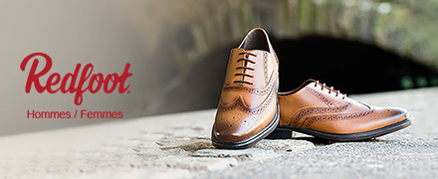


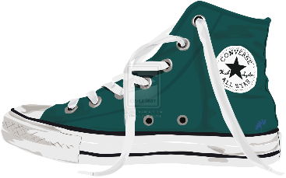
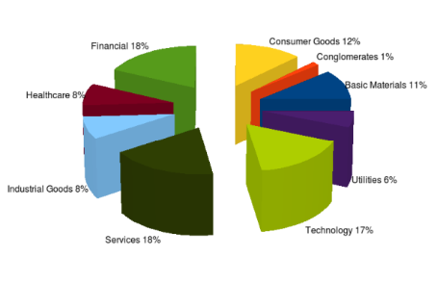

We have up to 4 perspectives
(= association spaces)
brand perspective
vitrine perspective
product perspective
sector perspective

Slide 7
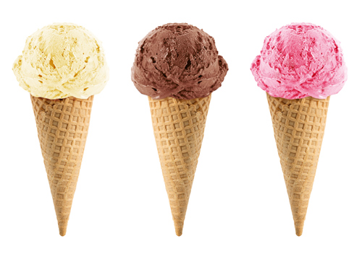
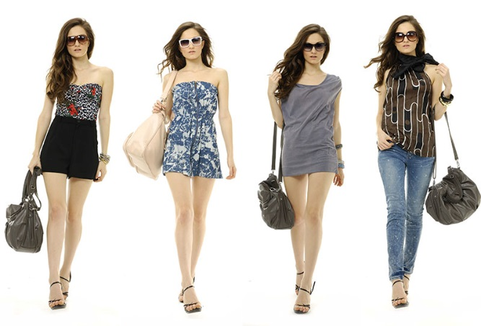
We have 2 modalities
(= type of dimensions for members)
# PREFERENCES.
They are stable over time.
# TRENDS.
They are current.

Slide 8
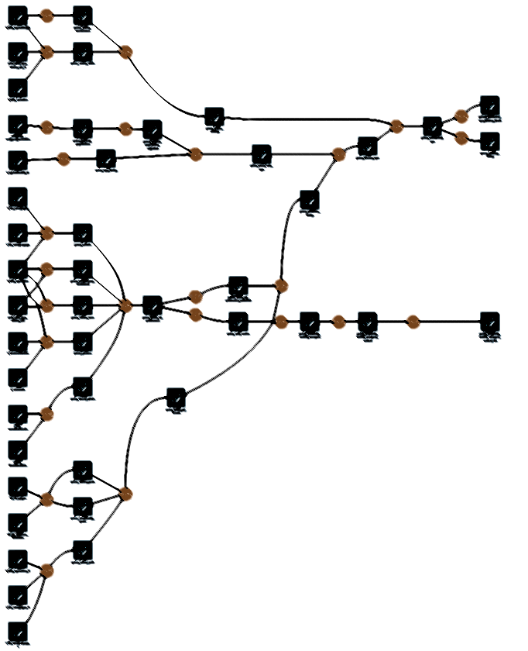
PERSO - curent state
The main technique used is ‘collaborative filtering’.
The applied variation is ‘item based’, with brands as items.
Similarity between brands is calculated as a cosinus between two normalized vectors (brand m and brand n), with the known score of each member corresponding to a dimension.

Slide 9
PERSO - curent state
The preferences are evaluated as a function of visits, purchases, abandoned baskets, the level of repetition and brand alerts (made during 1 year period). The preferences are normalized per member and temporalized with a sigmoid function.
The individual trends are evaluated as a function of purchases and time spent.
The community dynamics is evaluated as a function of country, gender, age and time spent.

Slide 10
PERSO - curent state
The final order for each individual is composed of real scores and estimated scores.
The real score is composed of preferences, trends, community dynamics and favorite & uninteresting sectors.
The estimated score is calculated as a cartesian product between vector of (known) preferences and similarity matrix (between brands), taking into account only 25 most similar brands and using the principles of fuzzy logics.

Slide 11
Analysis
First of all, we need more data !
Especially product type
Then, we need a lot of A/B testing for evaluation:
Quite ‘unsupervised’ process
Quite hard to evaluate performances of chosen parameters

Slide 12
Product Classification

Slide 13
Product Classification
Situation :
Vente-privée didn’t have a unified nomenclature for all of its product until very recently
This nomenclature, based on the publicly available GS1 nomenclature, doesn’t cover all products sold yet
Right now, products are classified at the end of a sell preparation, not when products arrive at the warehouse. Which means… too late !
So ? What if we used product pictures and brands (unnormalized) description to create a automatic classifier ?
It means :
Collecting training datasets
Training classifiers with image and/or text inputs
Putting the whole machinery as early as possible in the product lifecycle

Slide 14
Product classification
What for ?
Classify historical, unlabelled data, to make it available for further data mining
Speed up human labellization (can range from making suggestion to fully automatized classification)
Check errors between product image and brand description
The data :
Vente-privée owns a database of more than 1.5 million images, manually labelled, with 8 to 10 labels per image
The labels cover a huge range of attributes : type of product, gender destination, age destination, colors, patterns, and many other subtleties…
Each image has a brand-provided, unnormalized, human-made description

Slide 15
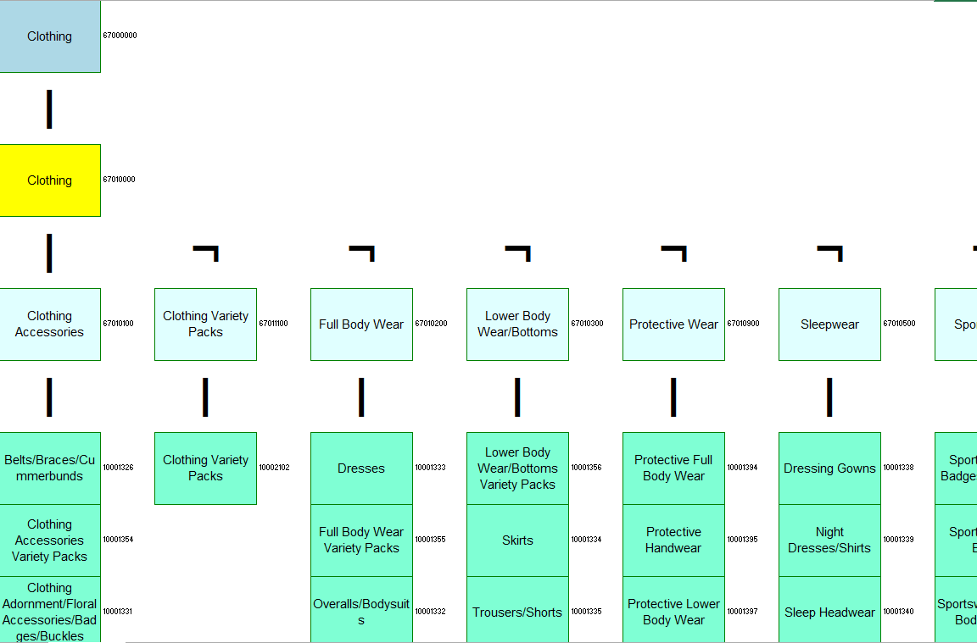

Nomenclature GS1
Four levels of classification :
Segment
Family
Class
Brick
A lot of ‘attributes’
SEGMENT
FAMILY
CLASSES
BRICKS

Slide 16
Product classification
Machine-Learning stage :
First iteration : Image-only input, Imagenet CNN (2012) without pretraining, powered by Tensoflow
Poor results : Good recall, interesting accuracy for high-level features, but perform poorly on fine features
Second iteration : Image and/or text description, InceptionV3 pretrained, powered by Keras
Better results : very good recall, but still too low accuracy for some fine features
Next iteration : what is the problem, what are the solutions ?
The problem : GS1 attributes can be too fine, we need an unsupervised relabelling, by merging some attributes

Slide 17



Social Networks Analysis Minhui WU

Slide 18
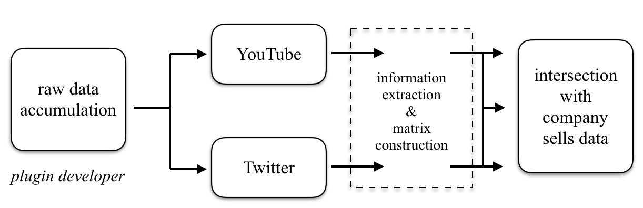


Using social networks data, we want to find brands that are similar in their associated keywords/user-made description 1. in order to improve marketing processes 2. in order to improve automatic personalization
Goals

Slide 19
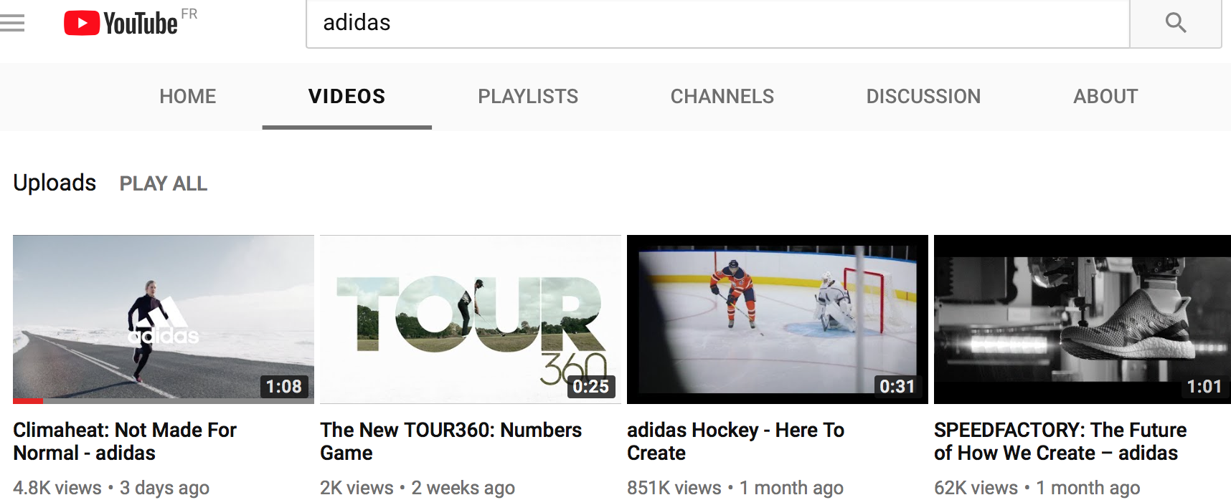
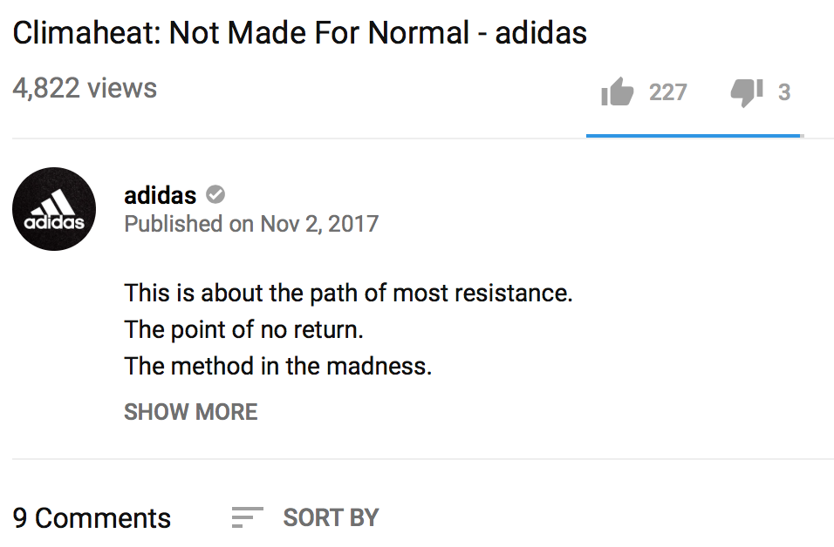
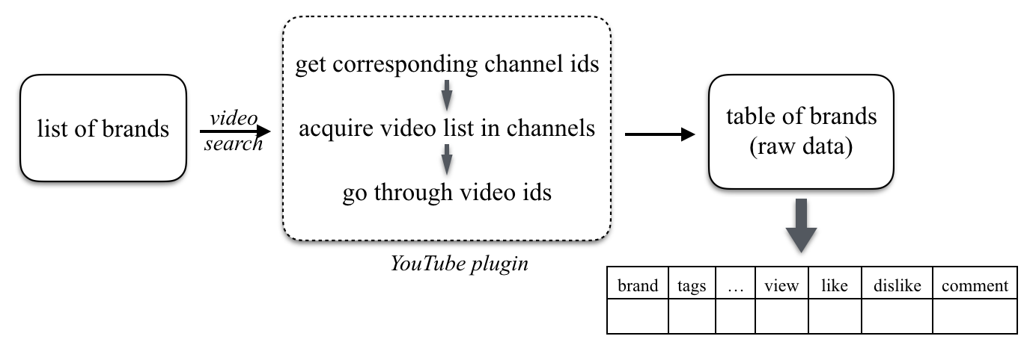
YouTube
Develop a plugin
A list of keywords to describe this brand
Notes:
Youtube used to show the list of all keywords used to tag a particular video in the description section but a few years back they stopped displaying this information.
Tags很有趣，将品牌之间的相似度转化为tags之间的相似度

Slide 20
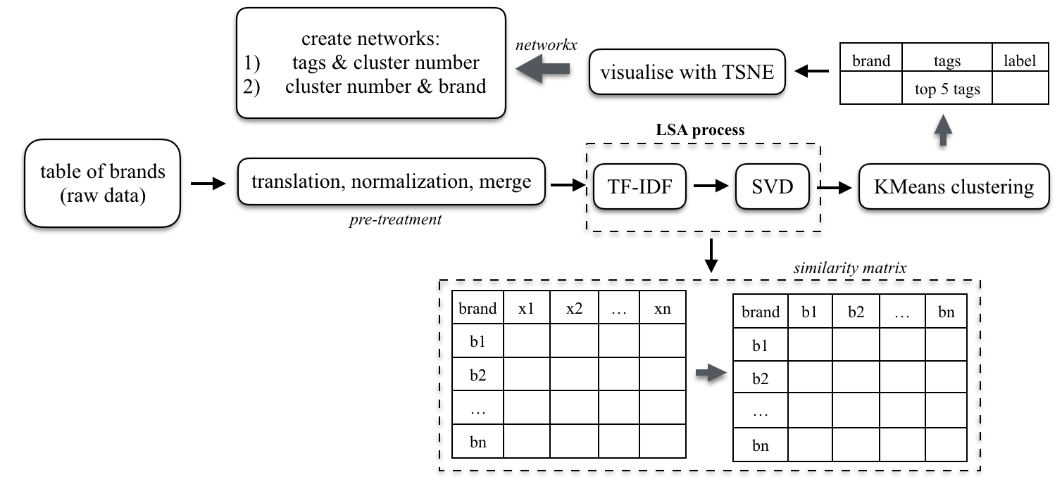
Youtube
3274*75
3274*45
stop_words =′ en′,
max_df = 0.4,
min_df = 220
81,6%

Slide 21
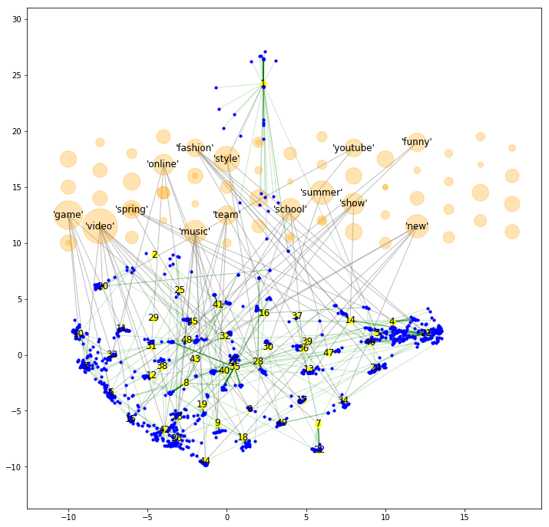
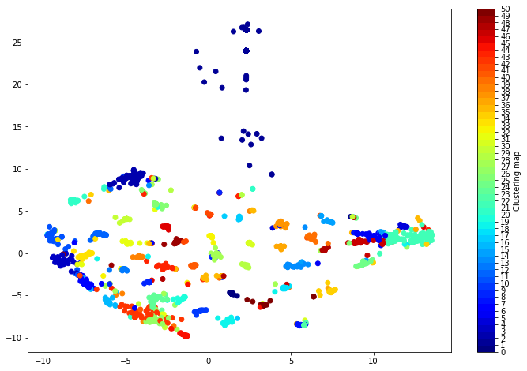
YOUTUBE
Youtube
Analysis of relationships :
tags & group
group & brands
‘‘ similar brand’’
ex,
’UGG’ ∊ Groupe 24
keyword ‘fashion’ ∊ Group 24
Display brands from the same group,
Or display brands that share the keyword ‘fashion’

Slide 22
Youtube – notoriety analysis
Notoriety score definition = log [(view-dislike) * (1+comment) * (1+like)]
brand | viewCount | commentCount | likeCount | dislikeCount | score | label | tags
Jamie Oliver | 1120266.0 | 1040.0 | 15577.0 | 240.0 | 30.530415 | 0 | ['food', 'video', 'spring', 'review', 'tip']
Brums | 505643.0 | 6.0 | 227.0 | 139.0 | 20.508569 | 4 | ['fashion', 'kid', 'child', 'school', 'video']
Claire | 425739.0 | 3119.0 | 8006.0 | 1649.0 | 29.991363 | 5 | ['summer', 'fashion', 'spring', 'collection‘]
Lou | 1618610.0 | 5491.0 | 61554.0 | 614.0 | 33.935434 | 6 | ['funny', 'moment', 'game', 'video', 'fun']
Leonardo | 9776614.0 | 5083.0 | 91860.0 | 8231.0 | 36.056547 | 12 | ['world', 'new', 'video', 'child', 'game']
Nike | 39255284.0 | 3578.0 | 96707.0 | 9645.0 | 37.147641 | 13 | ['sport', 'team', 'world', 'game', 'winter']
Stella Cadente | 232271.0 | 949.0 | 6219.0 | 171.0 | 27.946915 | 16 | ['tip', 'style', 'red', 'pro', 'day']
Ministry Of Sound | 4689301.0 | 1443.0 | 28504.0 | 795.0 | 32.893632 | 19 | ['dance', 'red', 'music', 'show', 'school']
Mgm | 1568304.0 | 5355.0 | 9993.0 | 4151.0 | 32.058569 | 20 | ['youtube', 'editor', 'video', 'game']
Burberry | 14981907.0 | 1178.0 | 18118.0 | 1232.0 | 33.399410 | 21 | ['fashion', 'style', 'spring', 'collection', '...
Gopro | 2533739.0 | 954.0 | 29104.0 | 587.0 | 31.885352 | 25 | ['black', 'gameplay', 'man', 'game', 'high']
Sia | 6657864.0 | 2012.0 | 53783.0 | 1103.0 | 34.211256 | 35 | ['life', 'online', 'school', 'high', 'ymy']
Converse | 237923.0 | 243.0 | 4264.0 | 26.0 | 26.234963 | 37 | ['holiday', 'christma', 'family', 'summer‘]
Sony | 1124157.0 | 1410.0 | 10459.0 | 1874.0 | 30.438244 | 40 | ['tv', 'show', 'music', 'new', 'video']
Seb | 4390575.0 | 62057.0 | 151781.0 | 7483.0 | 38.259290 | 42 | ['music', 'video', 'song', 'new', 'life']
Monster | 4478158.0 | 160.0 | 871.0 | 184.0 | 27.166875 | 43 | ['movie', 'film', 'high', 'school', 'time']
Dolce & Gabbana | 437232.0 | 241.0 | 2818.0 | 198.0 | 26.420844 | 46 | ['collection', 'fashion', 'spring', 'summer‘]

Slide 23
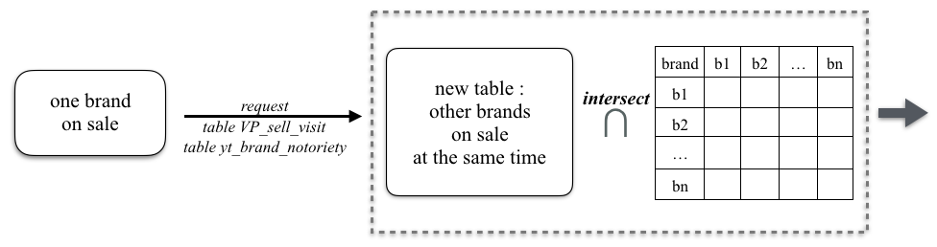
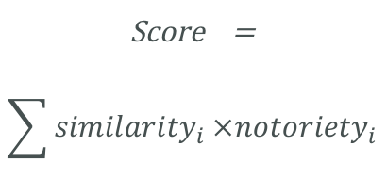
Youtube – competitors analysis
Suppose we have a brand ‘on sale’ on VP’s website
Number of visits : notoriety +, visits +; score +, visits +
Number of purchases : score -, purchase+
Score =
$$\sum{{similarity}_{i}}×{notoriety}_{i}$$
Notes:
analyse des autres marques simultanés sur le site;
Son notoriété et l’effets de concurrents sur lui sone bien prise en compte.

Slide 24
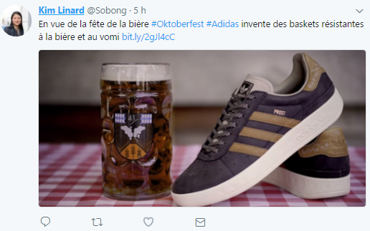
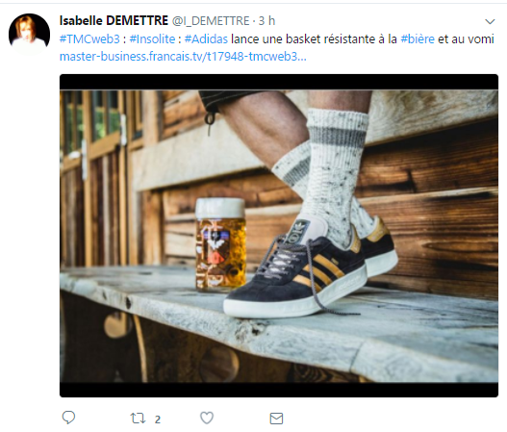
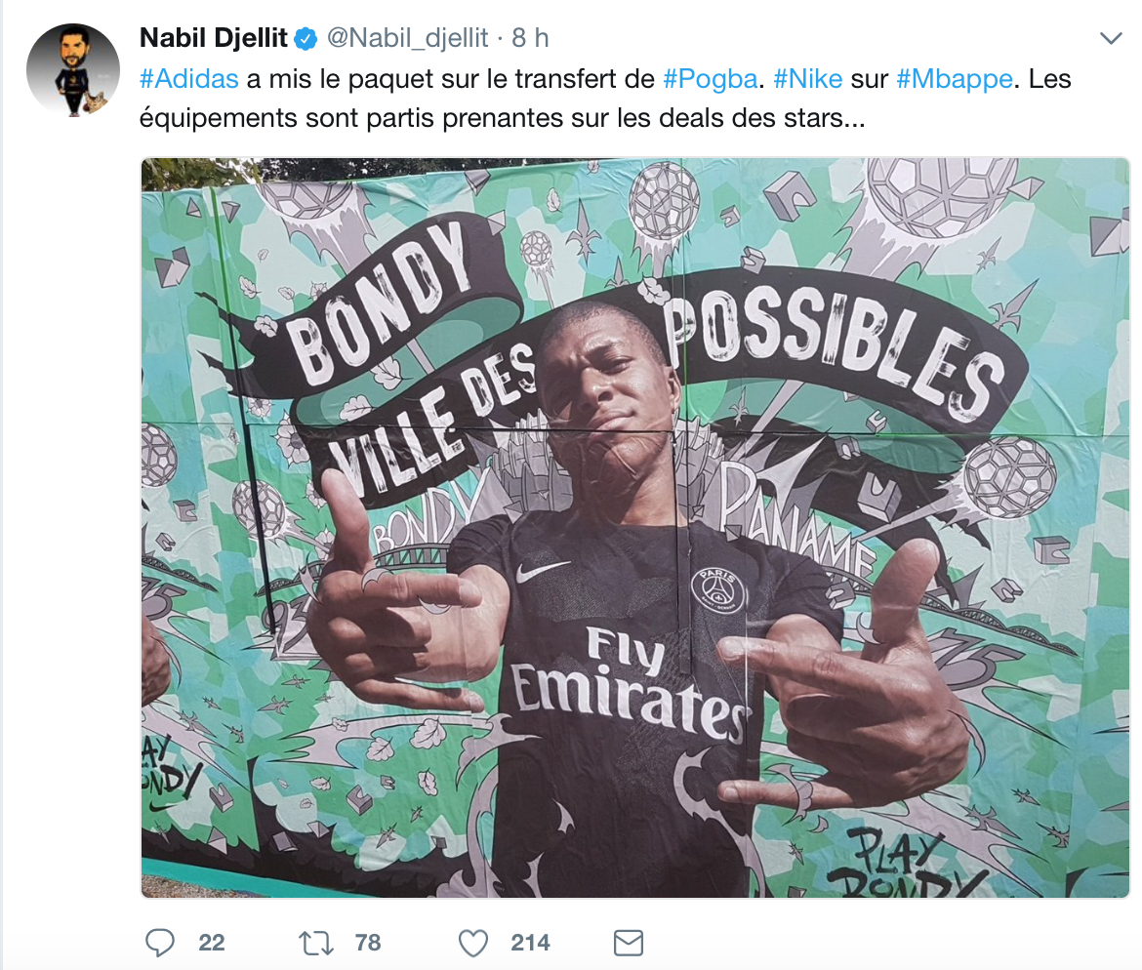
Twitter
Plugin : get keywords
We want to follow ‘#adidas’
For each context validated, we get all of tweet’s text

Slide 25
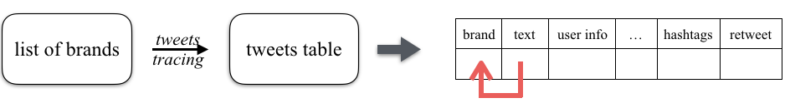

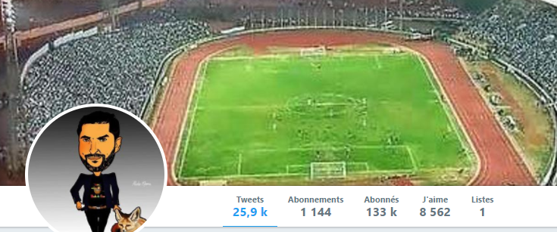
Twitter
1) Plugin development

Slide 26
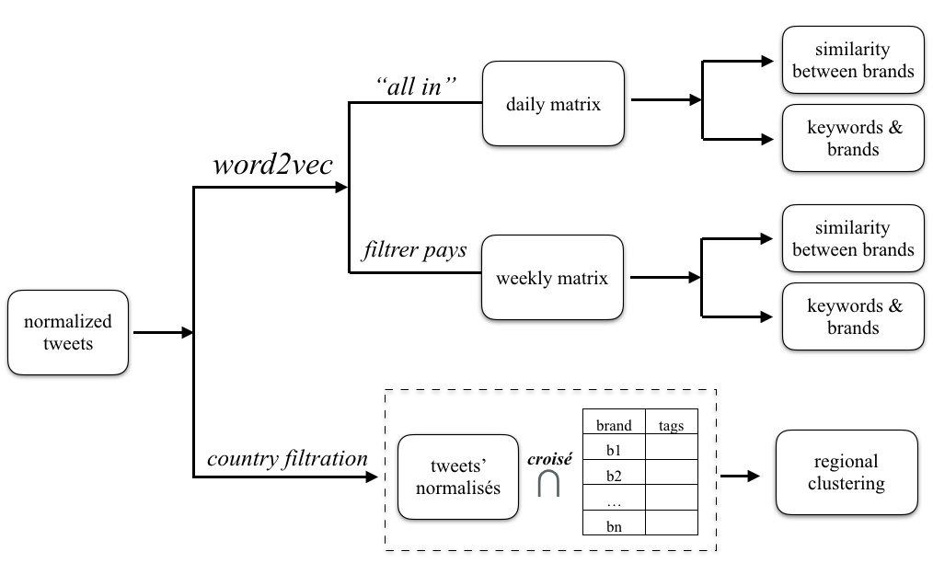
Twitter
2) Data processing
Notes:
matrice par jour
Similarité entre 2 marques
Effet de mot clé sur des marques

Slide 27
Perspectives
Social netorks :
can be a good marketing indicator
Can provide strategic insight
Can detect social tendencies (especially Twitter)
Brands-similarity matrix can be used to better understand intern data in VP
Regional analysis allow better personalization
Main problem : how to evaluate (without A/B testing) ?

Slide 28
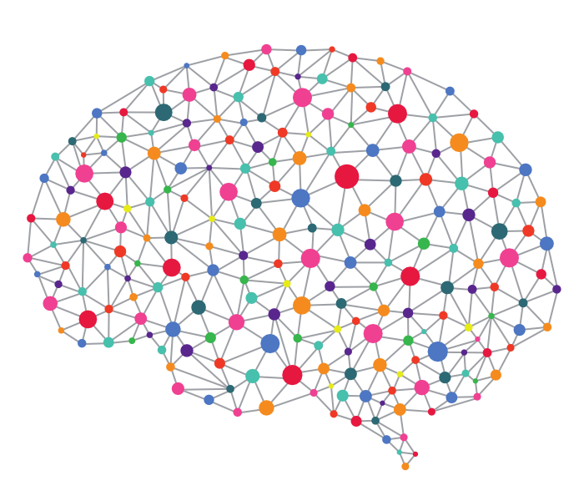
User Behavior Prediction (with Recurent Neural Networks)
Predict user behavior using navigation events
Farah Dhouib

Slide 29
User Behavior Prediction
Ultimate goal :
What will customers do next minute ??
There is a way to predict it.. If we have the data !
Data are available !
Mixpanel libraries are collecting members navigation event through all devices
Mixpanel API allows to gather and use these data
Which Algorithm ?
We need to predict a state, given a sequence of events
Recurrent Neural Networks !

Slide 30

You said neural networks ?
Reccurent neural networks are a kind of neural networks that can memorize a state over the steps
They suit well for data that implies sequence or list (for instance sentences)
They are applied in various kind of application like speech recognition, langage modeling, translation…

Slide 31

Long Short Memory Neural Networks
Long Short Memory Neural Networks (LSTM) are a kind of Reccurent Neural Networks (RNN) which perform better in memorizing information in long sequence
Indeed, RNN is limited in short memory and tends to forget after a few steps…
LSTM can save information in longer sequences

Slide 32
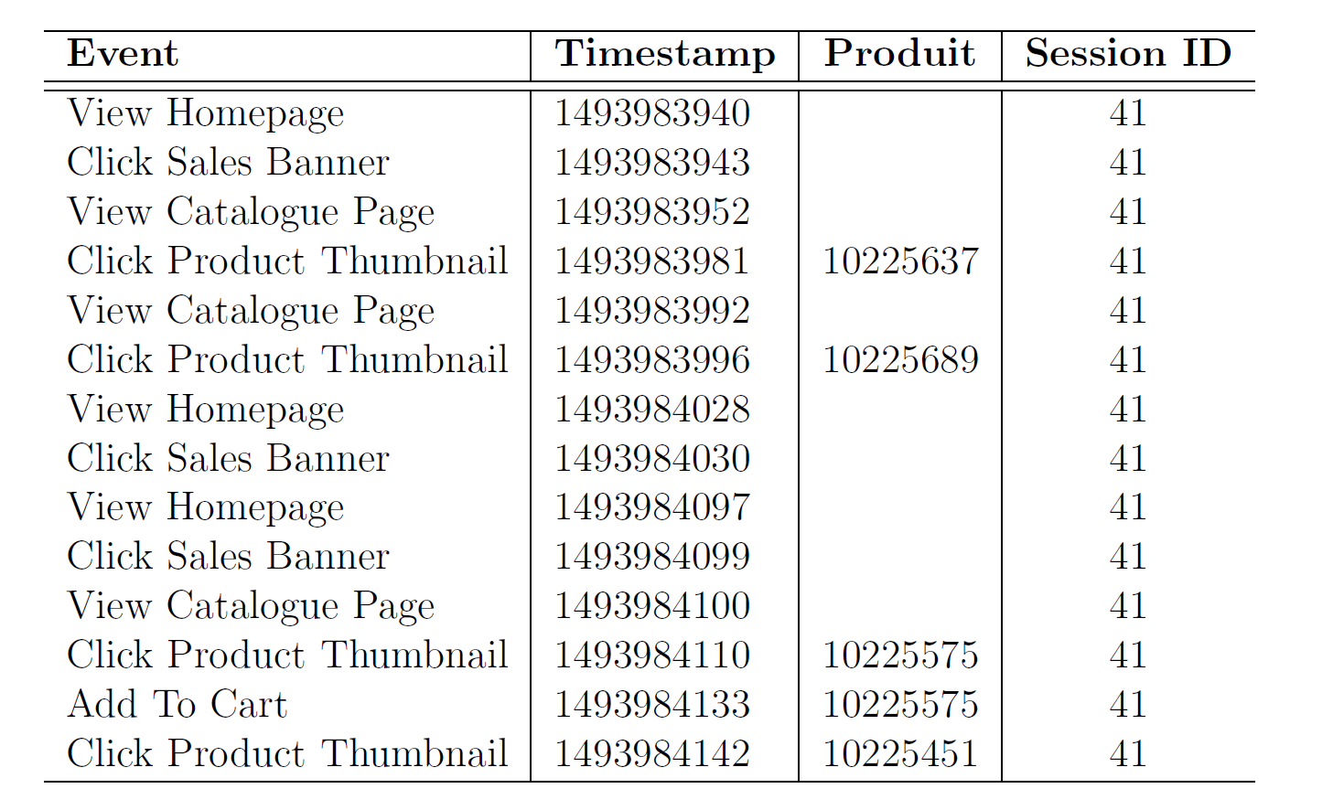
Data history
Example of a navigation sequence for one member and one session

Slide 33
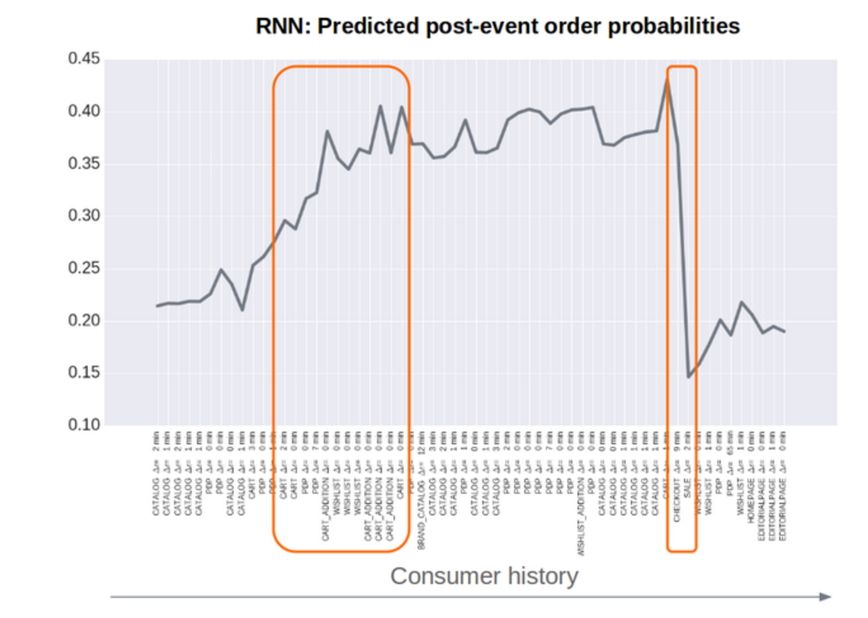
How it works

Slide 34
Analysis
First iteration :
We take sequences of events for active members
We put the sequences into a 256-cells LSTM…
To predict the probability of ‘member buy next week’ given the sequence of events of last 2 weeks
Results :
~90% accuracy
But :
Sampling bias on evaluation dataset ? We evaluated on active sequences too…
Better evaluation : ROC curve
Still improvement to do
Next iteration : add product labels as inputs !

Slide 35
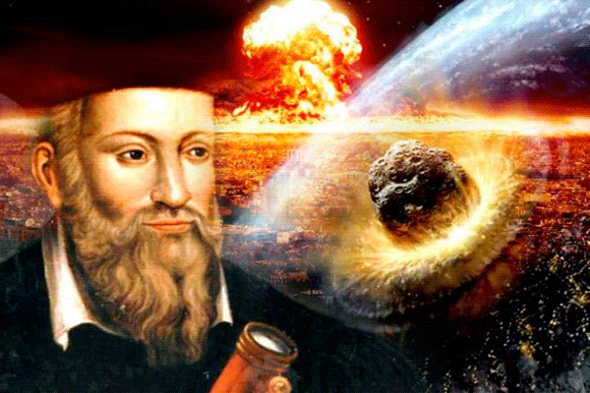
NOSTRADAMUS
Sell Flow Prediction

Slide 36
Goal & Methods
Provide to the supply chain a tool that allows, after the beginning of a sale, to get a prediction of how much products will be sold at the end of the sale, for each siteID and productID
What do we use ?
Main sector
siteID
Sell dynamics : for each productID, how many products did we sell at each hour ?
Which algorithm for the prediction ?
XGBoost ! eXtreme Gradient Boosting, a method to learn efficiently a classification using Decision Trees

Slide 37
Algorithm
What is XGBoost ?
eXtreme Gradient Boosting, a method to learn efficiently a classification using Decision Trees
a classification method, more precisely a supervised learning method (= we know the kind of output we want to obtain)
How does it works ?
We have a training dataset, i.e. a dataset where the various data are already human-labelled as expected
We train the algorithm to reproduce the output (=the labels, in our case the number of items sold) of the training dataset given the same input
We evaluate the classification performances of the algorithm on another human-labelled dataset

Slide 38
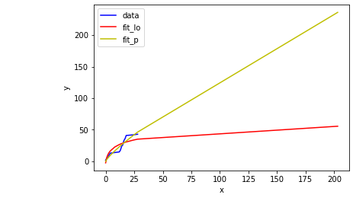
XGBoost for Nostradamus
The input :
Already recorded sales
Unitary_price
siteId
Retail_price
Discount
Num_ope
Month
Power function fit
Logarithmic function fit
Hours since sale’s start | 0 | 2 | 5 | 12
Cumulated number of products sold | 0 | 3 | 7 | 11

Slide 39
Performances and next steps
Global performances : around 90% of accuracy
Next steps :
Further increase performances
Allow pre-start estimation
Include product type and other characteristics
Use more fitting curves than plain log and power
etc.

Slide 40
Next Projects !!
That’s not all yet folks…

Slide 41
Next Machine Learning Projects at VP :
Sell Flow ante prediction (‘Nostradamus ++’) :
predicting number of products sold at the end of a sale, WITHOUT first sells recorded
Unsupervised image tagging :
Automated tagging of custom pictures’ stock for efficient human browsing
Visual SocioStyle :
Unsupervised clustering of clothes combinations, combined with customers’ socio-demographic data
Email personalization :
Fine tune email sending according to customer behavior online
Chatbot and Personal Assistant :
‘Hi VP, what should I wear today ?’

Slide 42
Sell Flow ante prediction (‘Nostradamus ++’)
Vente-privée critical need : ship faster
How to do that : for many sells, products are not yet in warehouses, we wait for sufficient orders
Nostradamus is a first response, but we still need to wait to see the dynamics !
Can we provide predictions before the opening of sells (= without observed dynamics ?)
One of VP’s ML team biggest challenge
How to do that ?
Add product type to the training inputs
Explore other prediction methods (RNNs ?)
Use brands similarities to get insights about previous dynamics
And mostly update models all the time ! … dynamics are always varying !

Slide 43








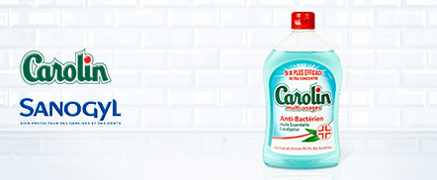





Unsupervised Image Tagging
Code opération
Business
Secteur
Type de créa
Source fournie (DMAP)
Lounge
Mois & Année d’ouverture
Mois & Année de production
Technique employée
Complexité de la tâche
Prod externalisée
Shooting ambiance
Responsable artistique
Coordinateur
Créatif PPM
Créatif PROD
Responsable shooting
Assistant shooting
Photographe
Mannequin
hmup
Studio
Nom marque
Pays d’ouverture
Qualité DA
Résultat : 1 000 réponses
1
Sur 84 pages
Tous
NYDJ2 – ouverture février 2016
VPV_XXX – ouverture février 2016
OD_XXX – ouverture février 2016
Nouvelle créa
Février 2016
RZD_XXX – ouverture février 2016
M_XXX – ouverture février 2016
XXX – ouverture février 2016
XXX – ouverture février 2016
XXX – ouverture février 2016
RZD_XXX – ouverture février 2016
XXX – ouverture février 2016
XXX – ouverture février 2016
AZURA1 – ouverture février 2016
Tous
FILTRER

Slide 44
Unsupervised Image Tagging
Business need : quickly and easily browse through all kinds of images created by VP
Banners
Products’ images
Pop up
Models’ shootings
Etc.
Machine Learning need : we need some kind of unsupervised learning for visual features
Insights for nexts works :
begin with an efficient CNN (+RNN for including metadata) classifier on ImageNet
Transform it into an autoencoder

Slide 45
Visual Socio Style
Another business need :
can we match business rules for clothing ‘styles’ with machine-calculated ‘styles’ ?
What we have :
Set of images for socio-styles defined by creation department : full-size models with clothing on them
Set of images associated with products… associated with tags, labels, type of products !
What we began to do :
Auto-encoders CNN, for unsupervised clustering of sociostyles pictures
Compare with human labels set on these images
Classify new images into existing sociostyles !

Slide 46
Email Personalization
Currently, vente-privée is sending huge amount of emails :
for customers targeting
for avoiding churn
Right now : email sending is driven by business rules
Next step : email sending is driven by Machine Learning !
What to do :
Use Member Behavior Prediction to compute Churn Probability
But mostly : we still need to gather data, through A/B Testing and other means, to allow machine learning models

Slide 47
GLOBAL CONCLUSIONS – BUSINESS PERSPECTIVE
Gathering data is extremely difficult and time costly Most data scientist time spent on engineering… for the moment
Business rules are sometimes far more efficient (in terms of ROI) than ML…
But ML is often far more efficient than nothing at all !
A/B test is the one judge
Everything is linked : better data on one side leads to better data on another side example : product classification
Garbage in… garbage out !
Good algorithms are scalable algorithms

